Slide 1
Splines, Local Regression, and GAM
UIUC ECON 490: Applied Machine Learning in Economics

Slide 2

Polynomial Regression
$$wage_{i}=wage_{0}+experience_{i}β_{1}+experience_{i}^{2}β_{2}+ε_{i}$$
$$y_{i}=β_{0}+x_{i}β_{1}+z_{i}β_{2}+x_{i}z_{i}β_{3}+x_{i}^{2}β_{4}+z_{i}^{2}β_{5}+ε_{i}$$
lm(y ~ poly(x, z, degree = 2), data = df)

Slide 3
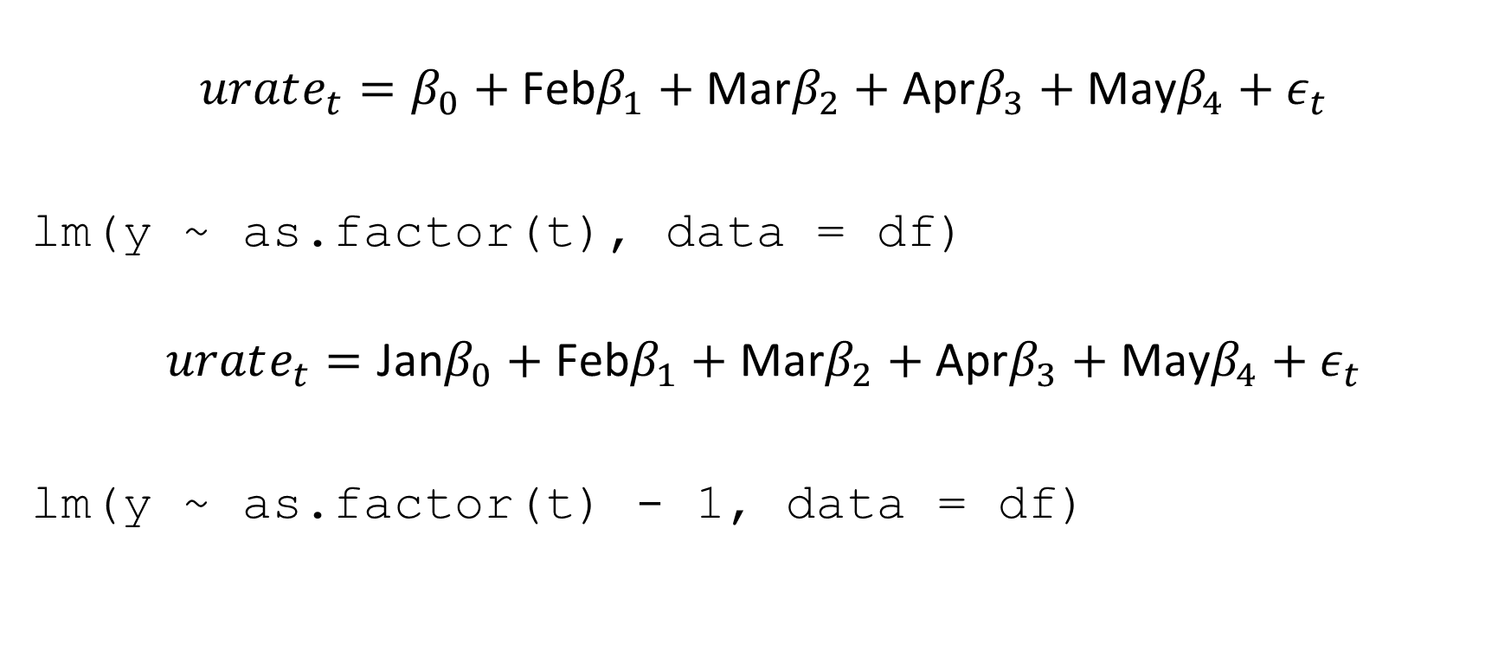
Step/Piecewise Functions
$$urate_{t}=β_{0}+\text{Feb}β_{1}+\text{Mar}β_{2}+\text{Apr}β_{3}+\text{May}β_{4}+ε_{t}$$
lm(y ~ as.factor(t), data = df)
$$urate_{t}=\text{Jan}β_{0}+\text{Feb}β_{1}+\text{Mar}β_{2}+\text{Apr}β_{3}+\text{May}β_{4}+ε_{t}$$
lm(y ~ as.factor(t) - 1, data = df)

Slide 4
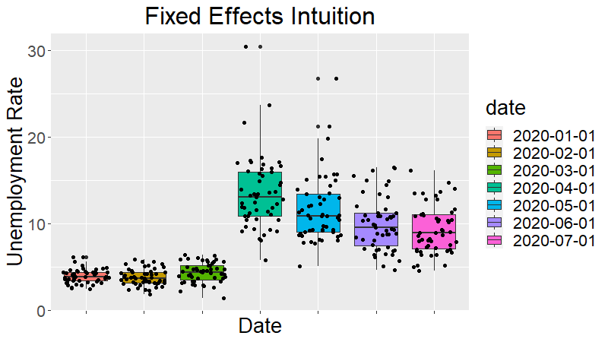
Time Fixed Effects

Slide 5

Piecewise Polynomials
$$urate_{t}=\left\{\begin{matrix}β_{0}+tβ_{1}+t^{2}β_{2}+ε_{t} & \text{if} t<c \\ α_{0}+tα_{1}+t^{2}α_{2}+ξ_{t} & \text{if} t≥c\end{matrix}\right.$$
lm(y ~ poly(t,2)*I(t >= c), data = df)

Slide 6
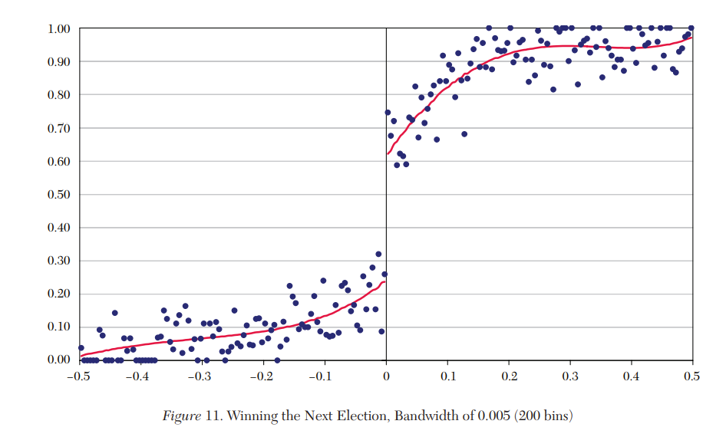
Piecewise Polynomials Motivation
Lee & Lemiuex 2010 Regression Discontinuity Designs in Economics

Slide 7
Splines and Local Regression
Non-linear Smoothers

Slide 8
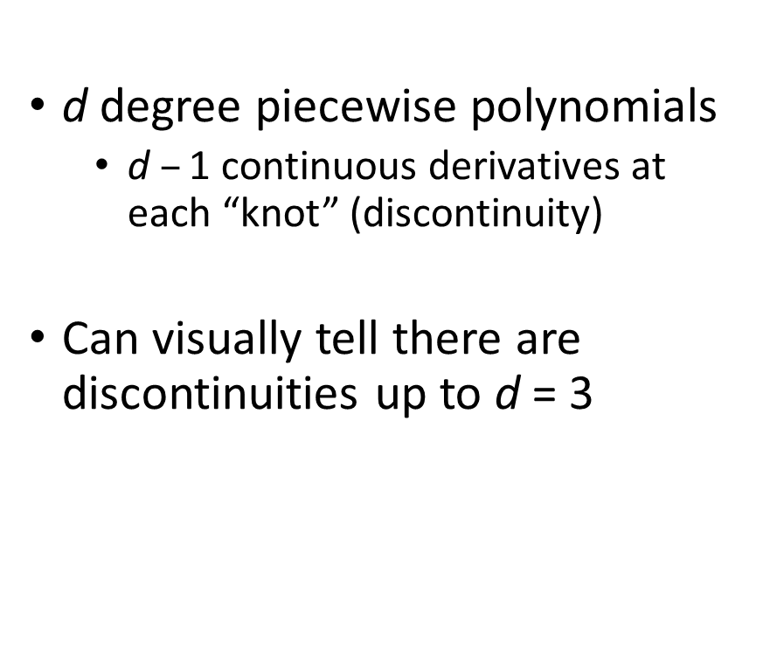
Splines
$\text{d}$degree piecewise polynomials
$\text{d} –\text{1}$ continuous derivatives at each “knot” (discontinuity)
Can visually tell there are discontinuities up to $\text{d} \text{=} \text{3}$
Natural splines
Only first derivative non-zero
“Boundary condition”
Reduce variance at ends

Slide 9
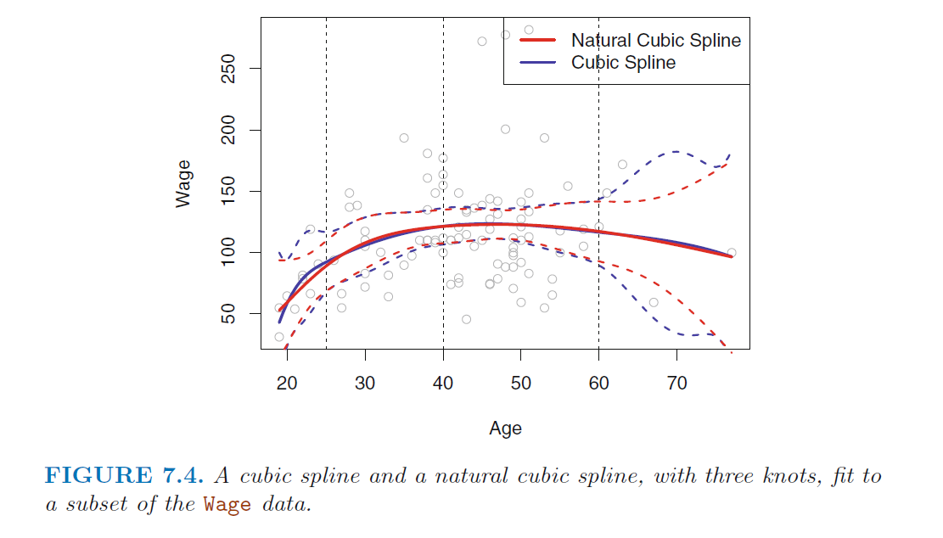
Natural Cubic Splines

Slide 10
Knots – Location and Quantity
Can place as many as you want, wherever you want
In practice, uniformly place along quantiles of data
Typically 3 knots (25%, 50%, 75%)
Alternatively…
CROSS-VALIDATION!

Slide 11
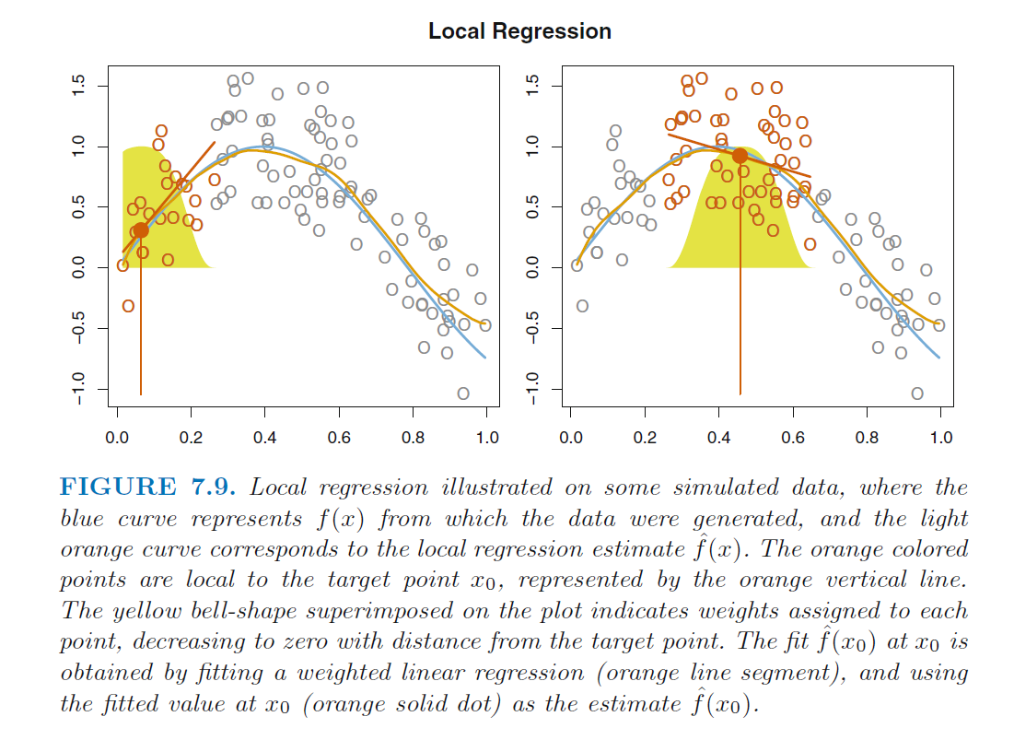
Local Regression

Slide 12

Generalized Additive Models
$$y_{i}=β_{0}+\sum_{j=1}^{p}{f_{j}}\left(x_{i,j}\right)+ε_{i}$$
$f_{j}\left(x_{i,j}\right)$ can be non-linear i.e. spline, local regression
Trevor Hastie and Robert Tibshirani 1986

Slide 13
To Do
Read
Ch 8.1 – Tree-based models
Complete
Lab 7.8

